Slide 1
ZOMATO
Data-Driven Recommendations for New Market Entry
Restaurant
Expansion
Strategy
Zomato Global Restaurant Dataset
Prepared by: Jeetri Sanjana

Slide 2
Problem Statement
Zomato is looking to expand its restaurant network and needs to identify the most suitable markets for opening new restaurants, based on competition, customer ratings, and market potential.
1
2
3
Where?
How good is it there?
What should we serve, and how?
Which countries and cities carry the lowest competition today?
Are the restaurants already operating in those markets satisfying customers?
Which cuisines and service features (delivery, booking) actually move ratings?
2

Slide 3
Data Overview
9,542
15
2010-2018
20+
Restaurants analyzed
Countries covered
Years of openings
Attributes per record
What the dataset contains:
Cleaning steps applied before analysis:
Restaurant name, location (country, city, address)
Cuisines served, currency, price range (1-4)
Online delivery, table booking, and live-order flags
Votes, average cost for two, and customer rating
Country names attached to CountryCode via lookup
Missing cuisine values fixed, currency symbol errors fixed
Costs converted to a common USD basis for fair comparison
3

Slide 4
Where Are Zomato's Restaurants Today?
KEY INSIGHTS
India holds 8,652 of 9,542 restaurants (91%) - the market is saturated, not open.
Philippines (22), Indonesia (21) and Qatar (20) sit at the opposite extreme - a small, easily-benchmarked existing footprint.
USA (425) and UK (80) are mid-sized markets - more established than our targets, but far from India's scale.
4

Slide 5
Openings Have Been Steady, Not Explosive
KEY INSIGHTS
Roughly 1,000-1,100 new restaurants open every year across the dataset - no single year dominates.
2018 (1,102) and 2011 (1,096) are the busiest years; 2012 (1,022) the quietest - a gentle, not explosive, growth curve.
A steady pace means Zomato is not entering a fast-closing window - a phased rollout across the target countries is realistic.
5

Slide 6
Low Competition Doesn't Mean Low Quality
KEY INSIGHTS
Philippines (4.47), Indonesia (4.30) and Qatar (4.06) all rate well above the global average of 2.89.
India, despite having the most restaurants, has the lowest average rating (2.77) - a sign of saturation, not opportunity.
Combining this with the competition chart: Philippines, Indonesia and Qatar are the only countries that are both low-competition AND high-rated.
6

Slide 7
Most Restaurants Still Don't Deliver Online
KEY INSIGHTS
Only 26% of restaurants (2,451 of 9,542) offer online delivery - most of the market still hasn't adopted it.
Restaurants WITH delivery average a 3.48 rating vs. 2.81 without - a full 0.67-point lift.
In Qatar specifically, delivery lifts average rating from 4.03 to 4.70 - the single biggest swing seen in any recommended country.
7

Slide 8
Table Booking Is Even Rarer - and It Matters
KEY INSIGHTS
Just 12% of restaurants (1,158 of 9,542) offer table booking - an even bigger gap than online delivery.
In the Philippines, restaurants with booking (14 of 22) average 4.49 vs. 4.43 without - a smaller but real edge.
Qatar shows almost no booking adoption (1 of 20 restaurants) - a clear, low-competition feature gap to fill early.
8

Slide 9
Which Cuisines Earn the Best Ratings?
KEY INSIGHTS
The single highest-rated cuisine combos in our target countries all score 4.8-4.9/5: Chinese in Qatar, Japanese/Sushi and fusion menus in the Philippines, and Sunda/Indonesian.
Cuisine choice clearly moves ratings - broader, unfocused menus in the same markets sit closer to 3.6-4.0.
Recommendation: lead new openings with a focused, locally-resonant cuisine rather than a generic multi-cuisine menu.
9

Slide 10
Price-Tier Gaps in the Target Countries
KEY INSIGHTS
India is dominated by the lowest price tiers (83% in Range 1-2) - a mass-market, price-sensitive base.
Indonesia is almost entirely mid-tier (95% Range 3) and Qatar skews to the top (70% Range 4) - both are missing an accessible, lower-priced option.
Philippines has the most balanced spread - a useful reference point for how to mix tiers in a new market.
10

Slide 11
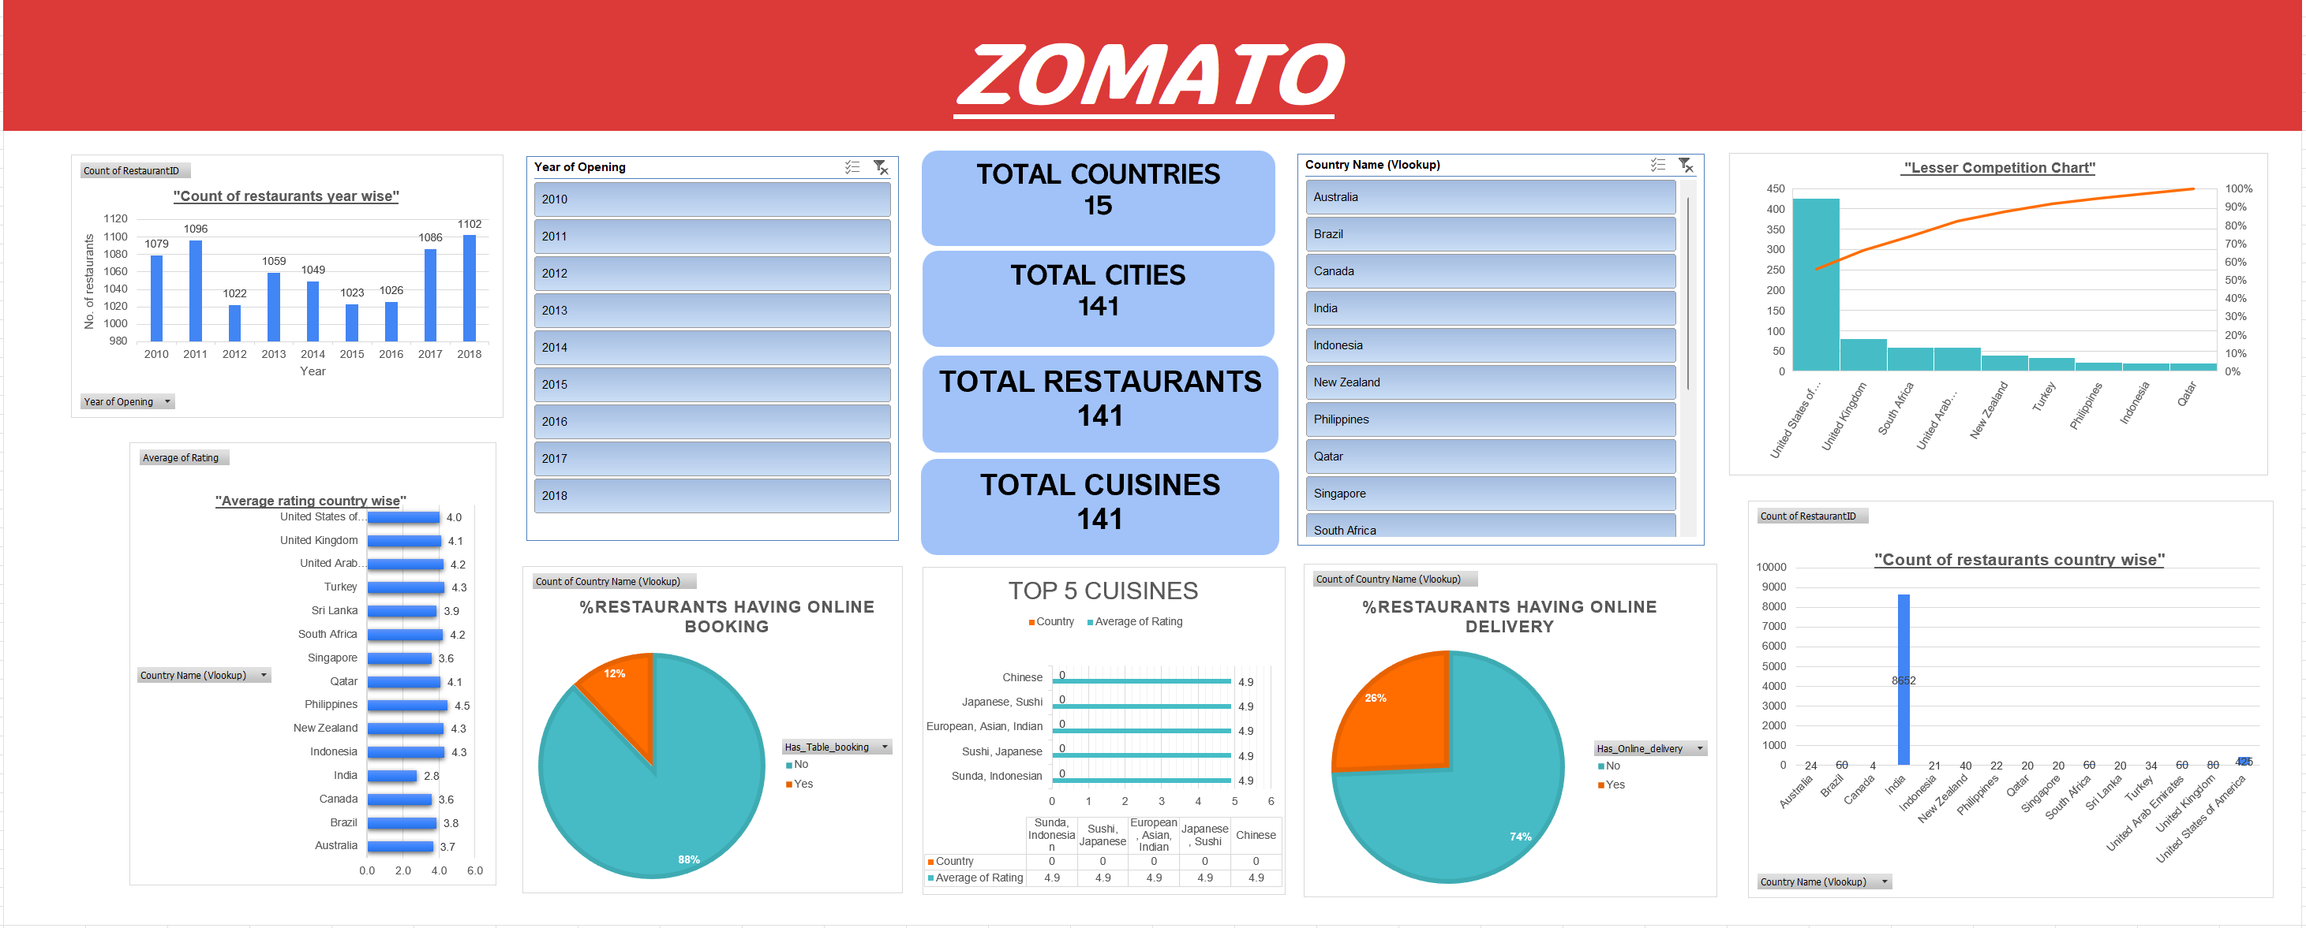
The Zomato Analytics Dashboard
ZOMATO EXPANSION STUDY
11

Slide 12
Recommendation: Where & How to Expand
Country | Restaurants Today | Avg. Rating | Best Cities | Avg Cost/2 (USD)
Philippines | 22 | 4.47 | Makati, Taguig, Pasig, Mandaluyong | $116.69
Indonesia | 21 | 4.30 | Jakarta, Bandung, Tangerang | $18.22
Qatar | 20 | 4.06 | Doha | $61.47
Cuisine & Menu
Service Features
Pricing
Lead with a focused, high-rated cuisine per market: Chinese/Indian in Qatar, Japanese/fusion in the Philippines, Sunda/Indonesian in Indonesia
Avoid broad, unfocused multi-cuisine menus
Launch every location with online delivery from day one - it lifts rating by ~0.67 points on average
Add table booking early, especially in Qatar where adoption is near-zero (1 of 20 restaurants)
Indonesia and Qatar both lack an accessible lower-price tier - fill that gap
Use Philippines' balanced price mix as a reference model
12

Slide 13
Conclusion
India is saturated (91% of listings) and low-rated (2.77) - not where growth should come from.
Philippines, Indonesia and Qatar are the only markets combining low competition with above-average ratings (4.06-4.47).
Online delivery and table booking are the two clearest, most under-used levers for improving ratings in these markets.
A focused, locally-resonant cuisine outperforms a broad multi-cuisine menu in every recommended country.
Expand where the data points - not where the crowd already is.
13

